Slide 1
Chapter 4: Threads

Slide 2
Chapter 4: Threads
Overview
Multithreading Models
Thread Libraries
Threading Issues
Operating System Examples
Windows XP Threads
Linux Threads

Slide 3
Objectives
To introduce the notion of a thread — a fundamental unit of CPU utilization that forms the basis of multithreaded computer systems
To discuss the APIs for the Pthreads, Win32, and Java thread libraries
To examine issues related to multithreaded programming

Slide 4
Motivation
Threads run within application
Multiple tasks with the application can be implemented by separate threads
Update display
Fetch data
Spell checking
Answer a network request
Process creation is heavy-weight while thread creation is light-weight
Can simplify code, increase efficiency
Kernels are generally multithreaded

Slide 5
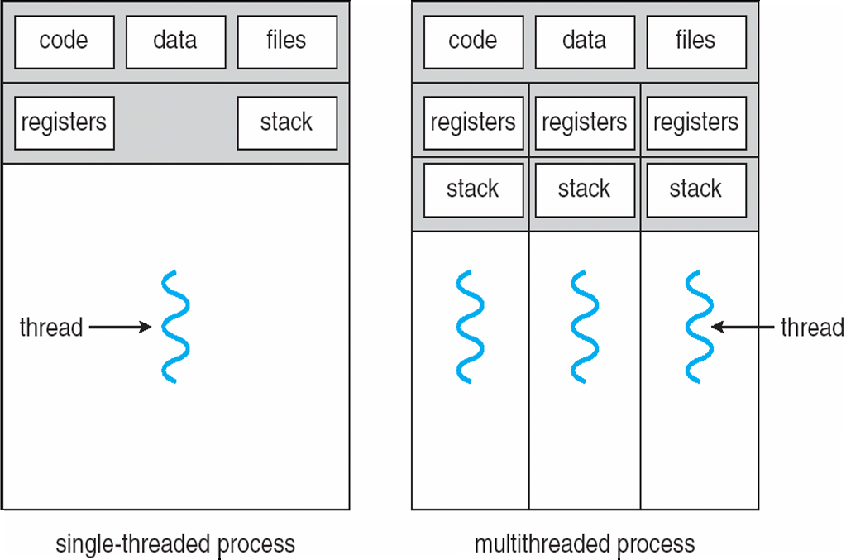
Single and Multithreaded Processes

Slide 6
Example of Web Server which instead of creating a new process for every new client request can create a separate thread of each new request and then still listen for another client request.
RPC also can allow inter process communication by multithreading concept.
So the RPC server can service several concurrent requests.

Slide 7
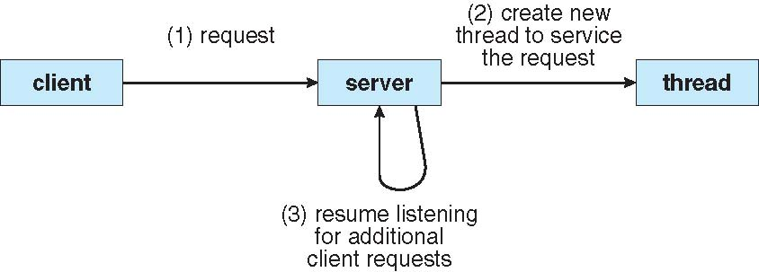
Multithreaded Server Architecture

Slide 8
Benefits
Responsiveness : two different threads for different activities so high response to every request.
Resource Sharing: sharing is efficient in case for threads rather than processes.
Economy: Cost efficient and time efficient in terms of memory for thread rather than process.
Scalability: Multiprocessor benefits.

Slide 9
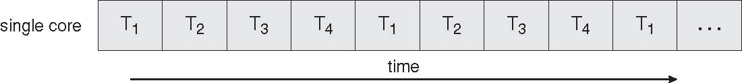
Concurrent Execution on a Single-core System
Each core appears as a separate processor to the OS. Multithreaded programming provides a mechanism for
more efficient use of multiple cores and improved concurrency. Consider an application with four threads. On
a system with a single computing core, concurrency merely means that the execution of the threads will be
interleaved over time as the processing core is capable of executing only one thread at a time. On a system
with multiple cores, however concurrency means that the threads can run in parallel as the system can assign
a separate thread to each core.

Slide 10
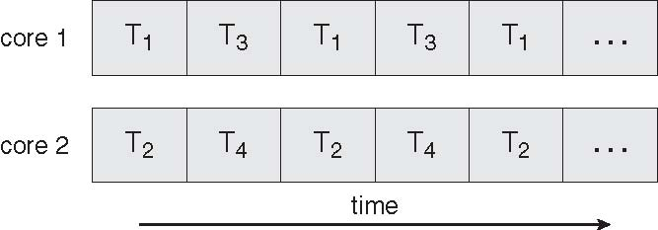
Parallel Execution on a Multicore System

Slide 11
Multicore Programming
Multicore systems put pressure on programmers, challenges include:
Dividing activities : separate concurrent tasks
Balance: tasks perform equal work of equal value.
Data splitting: Data needs to be splitted to be accessed and manipulated by the tasks.
Data dependency: Data accessed by the tasks must be examined for dependencies between tasks. In order for execution of tasks synchronization data dependency needs to be accommodated.
Testing and debugging: Different execution paths for a program running in parallel multiple cores. Needs to address each path for testing and debugging.

Slide 12
User Threads
Thread management or support for threads may be provided either at the user level for users threads or by kernel for kernel threads.
User threads are supported above the kernel and are managed without kernel support.
Kernel threads are supported and managed directly by the OS.
Thread management done by user-level threads library
Three primary thread libraries:
POSIX Pthreads
Win32 threads
Java threads

Slide 13
Kernel Threads
Supported by the Kernel
Examples
Windows XP/2000
Solaris
Linux
Tru64 UNIX
Mac OS X

Slide 14
Multithreading Models
Many-to-One
One-to-One
Many-to-Many

Slide 15
Many-to-One
Many user-level threads mapped to single kernel thread
Disadvantages: if a thread makes a blocking system call.
Examples:
Solaris Green Threads
GNU Portable Threads

Slide 16
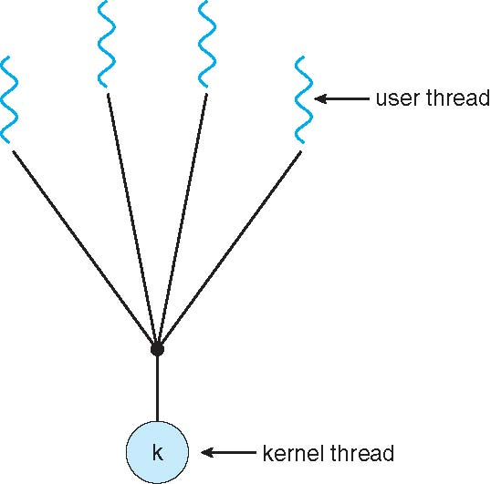
Many-to-One Model

Slide 17
One-to-One
Each user-level thread maps to kernel thread
Concurrent and parallel.
Drawback creation of kernel thread.
Examples
Windows NT/XP/2000
Linux
Solaris 9 and later

Slide 18
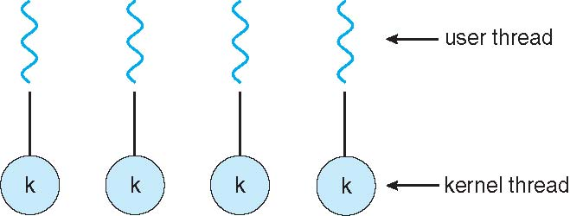
One-to-one Model

Slide 19
Many-to-Many Model
Allows many user level threads to be mapped to many kernel threads
Allows the operating system to create a sufficient number(equal or less) of kernel threads
Solaris prior to version 9
Windows NT/2000 with the ThreadFiber package
Solves all drawbacks of each above model:
Concurrency
Too many thread creation
Blocking system call prevention.

Slide 20
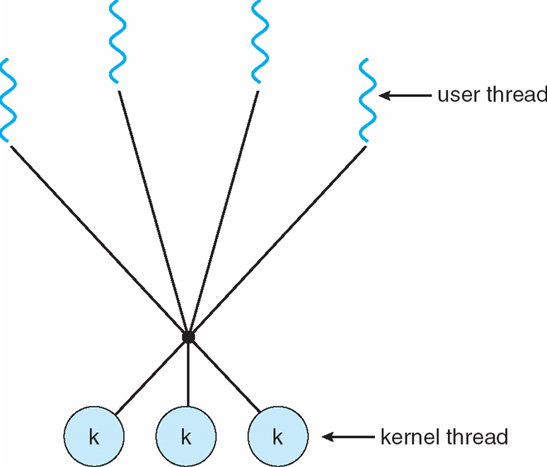
Many-to-Many Model

Slide 21
Two-level Model
Variation of above two-level model: may user level threads to a smaller or equal number of kernel threads similar to M:M, except that it allows a user thread to be bound to kernel thread
Examples
IRIX
HP-UX
Tru64 UNIX
Solaris 8 and earlier

Slide 22
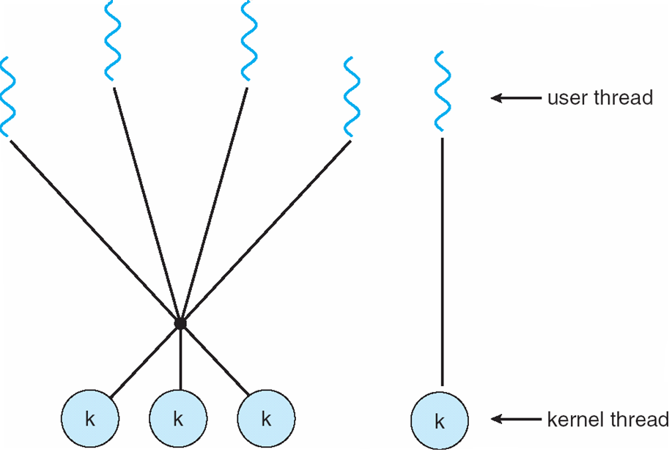
Two-level Model

Slide 23
Thread Libraries
Thread library provides programmer with API for creating and managing threads
Two primary ways of implementing
Library entirely in user space no support of kernel. No system call, local function.
Kernel-level library supported by the OS. Since code and data structures for library exist in kernel space so results in a system call to kernel.
Three libraries in user :
POSIX Pthreads (user or kernel)
Win32 (kernel)
Java.(Programs)

Slide 24
Pthreads
May be provided either as user-level or kernel-level
A POSIX standard (IEEE 1003.1c) API for thread creation and synchronization
API specifies behavior of the thread library, implementation is up to development of the library
Common in UNIX operating systems (Solaris, Linux, Mac OS X)

Slide 25
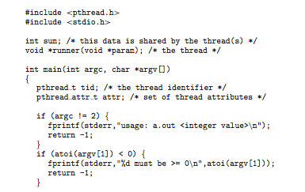
Pthreads Example

Slide 26
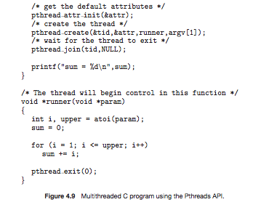
Pthreads Example (Cont.)

Slide 27
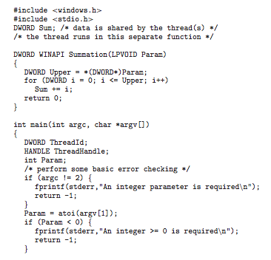
Win32 API Multithreaded C Program

Slide 28
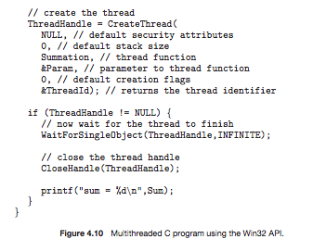
Win32 API Multithreaded C Program (Cont.)

Slide 29
Java Threads
Java threads are managed by the JVM
Typically implemented using the threads model provided by underlying OS
Java threads may be created by:
Extending Thread class
Implementing the Runnable interface

Slide 30
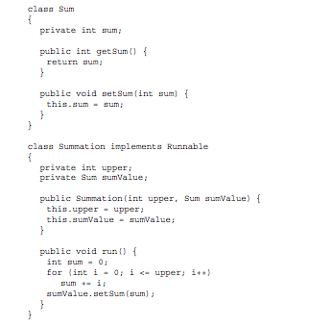
Java Multithreaded Program

Slide 31
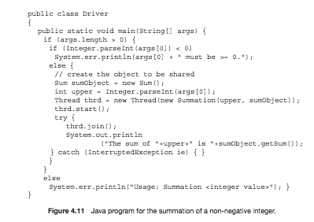
Java Multithreaded Program (Cont.)

Slide 32
Threading Issues
Semantics of fork() and exec() system calls
Thread cancellation of target thread
Asynchronous or deferred
Signal handling
Synchronous and asynchronous
Thread pools
Thread-specific data
Create Facility needed for data private to thread
Scheduler activations

Slide 33
Semantics of fork() and exec()
Does fork() duplicate only the calling thread or all threads?

Slide 34
Thread Cancellation
Terminating a thread before it has finished
Two general approaches:
Asynchronous cancellation terminates the target thread immediately.
Deferred cancellation allows the target thread to periodically check if it should be cancelled.

Slide 35
Signal Handling
Signals are used in UNIX systems to notify a process that a particular event has occurred.
A signal handler is used to process signals
Signal is generated by particular event
Signal is delivered to a process
Signal is handled
Signals can by synchronous or asynchronous.
Synchronous will be signals generated by a running process
Asynchronous will be signals generated by process other than running process.
Options:
Deliver the signal to the thread to which the signal applies -Synchronous
Deliver the signal to every thread in the process- Asynchronous Ctrl-C
Deliver the signal to certain threads in the process-Non blocking
Assign a specific thread to receive all signals for the process.
In windows does not explicitly provide support for signals they can be emulated using APCs.
This allows user thread to specify a function that is to be called when user thread receives notification of a particular event.

Slide 36
Thread Pools
Create a number of threads in a pool where they await work
Advantages:
Usually slightly faster to service a request with an existing thread than create a new thread
Allows the number of threads in the application(s) to be bound to the size of the pool

Slide 37
Thread Specific Data
Allows each thread to have its own copy of data
Useful when you do not have control over the thread creation process (i.e., when using a thread pool)

Slide 38
Scheduler Activations
Both M:M and Two-level models require communication to maintain the appropriate number of kernel threads allocated to the application
Scheduler activations provide upcalls - a communication mechanism from the kernel to the thread library.
The kernel provides an application with a set of virtual processors(LWP) and the application can schedule user thread onto an available virtual processor.
Furthermore the kernel must inform an application about certain events. This procedure is called upcall.
Upcalls are handled by a thread library with an upcall handler and these handlers must run on a virtual processor.
One event that triggers an upcall occurs when an application thread is about to block.
This communication allows an application to maintain the correct number kernel threads

Slide 39
Scenario in case of blocking:
The kernel makes an upcall informing application of block by the specific thread.
The kernel allocates a new virtual processor to the application.
Application runs an upcall handler on this new virtual processor which saves the state of the blocking thread and relinquishes the virtual processor on which the blocking thread is running.
The upcall handler then schedules another thread that is eligible to run on the new virtual processor.
When the event that the blocking thread was waiting occurs the kernel makes another upcall to the thread library informing that the previous thread is ready to run.
The upcall handler for this event also requires a virtual processor and the kernel may allocate a new one or preempt on of the user thread and run the upcall handler on its virtual processor.
The application after this runs normarly.

Slide 40
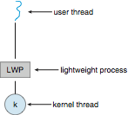
Lightweight Processes

Slide 41
Operating System Examples
Windows XP Threads
Linux Thread
Notes:
41

Slide 42
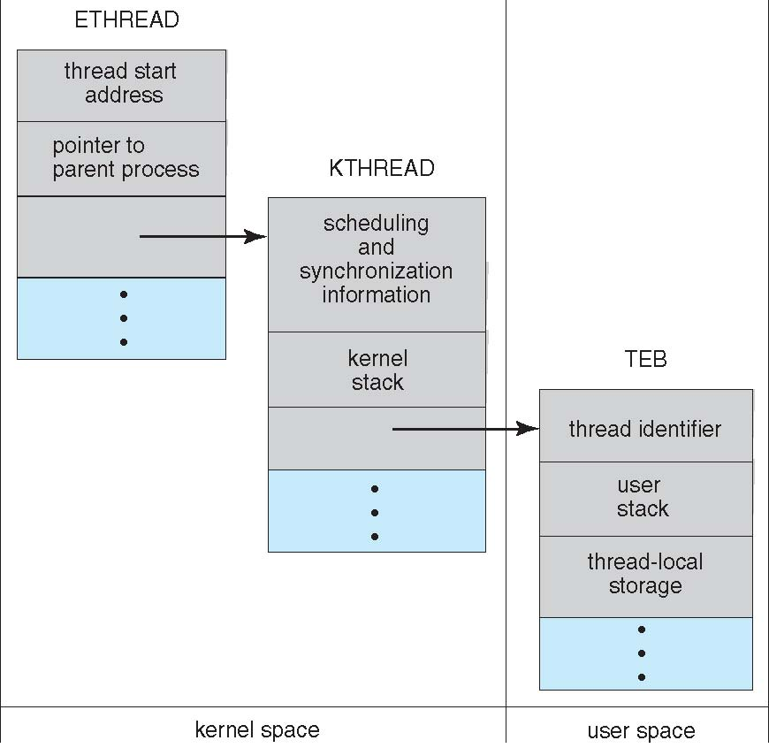
Windows XP Threads Data Structures

Slide 43
Windows XP Threads
Implements the one-to-one mapping, kernel-level
Each thread contains
A thread id
Register set
Separate user and kernel stacks
Private data storage area
The register set, stacks, and private storage area are known as the context of the threads
The primary data structures of a thread include:
ETHREAD (executive thread block)
KTHREAD (kernel thread block)
TEB (thread environment block)

Slide 44
Linux Threads
Linux refers to them as tasks rather than threads
Thread creation is done through clone() system call
clone() allows a child task to share the address space of the parent task (process)
struct task_struct points to process data structures (shared or unique)
fork() and clone() system calls
With parameters clone else same like fork.
With fork a new task created along with a copy of all the associated data structures of the parent process. A new task is also created when the clone system call is made but rather than copying all data structures the new task points to the data structures of the parent task depending on the set of flags passed to clone.

Slide 45
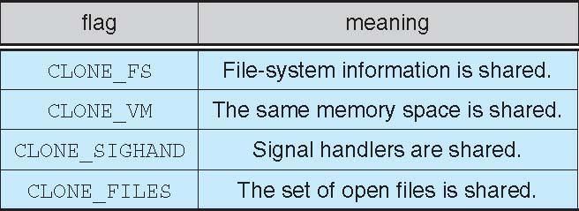
Linux Threads

Slide 46
Thread Scheduling
Distinction between user-level and kernel-level threads
When threads supported, threads scheduled, not processes
Many-to-one and many-to-many models, thread library schedules user-level threads to run on LWP
Known as process-contention scope (PCS) since scheduling competition is within the process
Typically done via priority set by programmer
A scheme PCS is implementing M-M or M-O model by scheduling user level thread to run on an available LWP. This is done by thread library.
By this it is not that the thread is actually running on a CPU; which would require the OS to schedule the kernel thread onto a physical CPU. To decide which kernel thread to schedule onto a CPU SCS is used.
Kernel thread scheduled onto available CPU is system-contention scope (SCS) – competition among all threads in system.
PCS is done according to priority set by programmer and not adjusted by the thread library although some thread libraries may allow the programmer to change the priority of a thread.
PCS will preempt the thread currently running in favor of a higher priority thread.

Slide 47
Pthread Scheduling
API allows specifying either PCS or SCS during thread creation
PTHREAD_SCOPE_PROCESS schedules threads using PCS scheduling
PTHREAD_SCOPE_SYSTEM schedules threads using SCS scheduling
Can be limited by OS – Linux and Mac OS X only allow PTHREAD_SCOPE_SYSTEM

Slide 48
Pthread Scheduling API
#include <pthread.h>
#include <stdio.h>
#define NUM THREADS 5
int main(int argc, char *argv[])
{
int i;
pthread t tid[NUM THREADS];
pthread attr t attr;
/* get the default attributes */
pthread attr init(&attr);
/* set the scheduling algorithm to PROCESS or SYSTEM */
pthread attr setscope(&attr, PTHREAD SCOPE SYSTEM);
/* set the scheduling policy - FIFO, RT, or OTHER */
pthread attr setschedpolicy(&attr, SCHED OTHER);
/* create the threads */
for (i = 0; i < NUM THREADS; i++)
pthread create(&tid[i],&attr,runner,NULL);

Slide 49
Pthread Scheduling API
/* now join on each thread */
for (i = 0; i < NUM THREADS; i++)
pthread join(tid[i], NULL);
}
/* Each thread will begin control in this function */
void *runner(void *param)
{
printf("I am a thread\n");
pthread exit(0);
}

Slide 50
End of Chapter 4

